Slide 1
MSL Tutorial
Course: EE735
25/09/2019

Slide 2
Group Ids:
Username : EE735_group_no ; Password is same as username
Ex: for group 1 , username is : EE735_1
hostID : 10.107.106.x (x=21,22,13,16,17)
Ex: For terminal 21, hostID is 10.107.106.21
Connection to MCL servers:
Linux system :
ssh -X username@hostID
Windows:
Mobaxterm

Slide 3
Overview
Structure specification
Numerical Solution
Material parameter Specifications
Result analysis

Slide 4
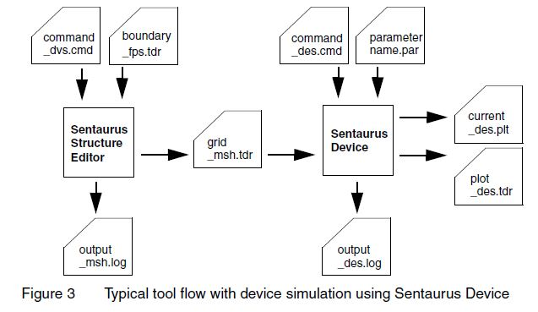
Simulation Flow

Slide 5
Structure specification SDE or Sprocess
SDE: Sentaurus Structure Editor can be used as a two-dimensional (2D) or three-dimensional (3D) structure editor, and a 3D process emulator to create TCAD devices
SProcess: Sentaurus Process is an advanced 1D, 2D, and 3D process simulator suitable for silicon and non-silicon semiconductor devices. It features modern software architecture and state-of-the-art models to address current and future process technologies

Slide 6
Structure Device Editor
Sentaurus Structure Editor can be used interactively by either using the GUI menu bar and toolbars, or entering the Scheme commands in the command-line window
To run Sentaurus Structure Editor in interactive mode, type in a command prompt: sde
To run a Scheme script file, for example MyScript.cmd, type in command prompt:
: sde -e -l MyScript.cmd

Slide 7
SDE
Drawing a region
Doping
Contact placement
Meshing
http://www.sentaurus.dsod.pl/sse/sse_a.html

Slide 8
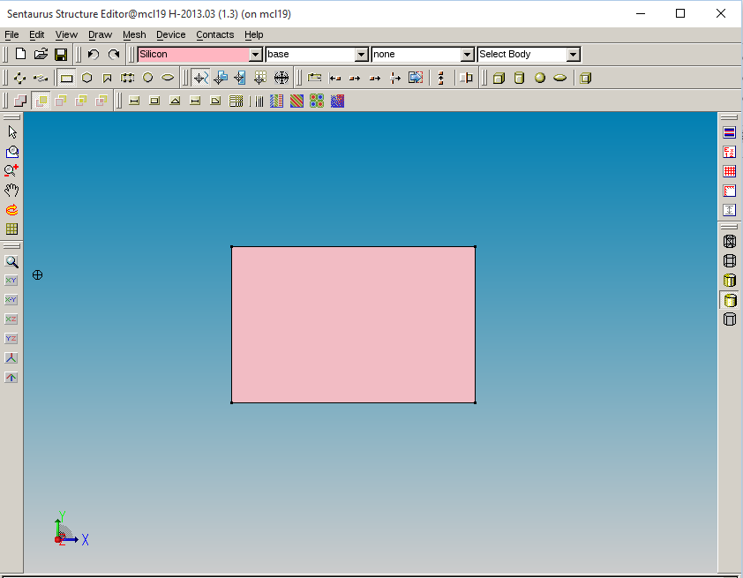
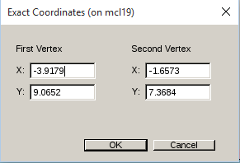
Drawing a region
You can set exact co-ordinates using Draw -> Exact Co-ordinates.
Code:
(sdegeo:create-rectangle (position x1 y1 0) (position x2 y2 0) "Silicon" "region_1" )

Slide 9
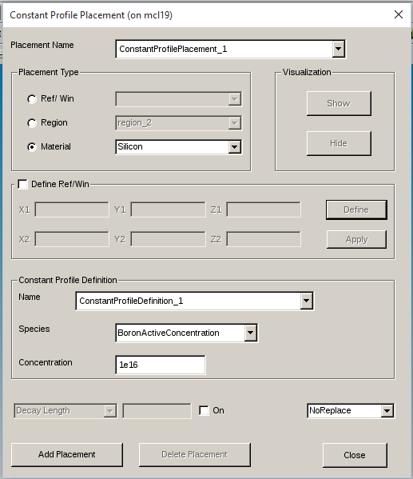
Doping
Doping can be done by clicking Device -> Constant Profile Placement
Code:
(sdedr:define-constant-profile "ConstantProfileDefinition_1" "BoronActiveConcentration" 1e16)
(sdedr:define-constant-profile-material "ConstantProfilePlacement_1" "ConstantProfileDefinition_1" "Silicon")

Slide 10
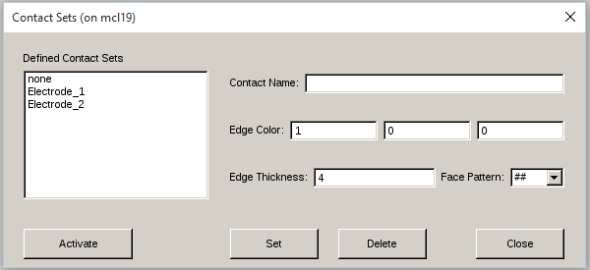
Contact placement
Go to Contacts-> Contact Sets
Define the contacts.
Code:
(sdegeo:define-contact-set "Electrode_1" 4 (color:rgb 1 0 0 ) "##" )
(sdegeo:define-contact-set "Electrode_2" 4 (color:rgb 1 0 0 ) "##" )

Slide 11
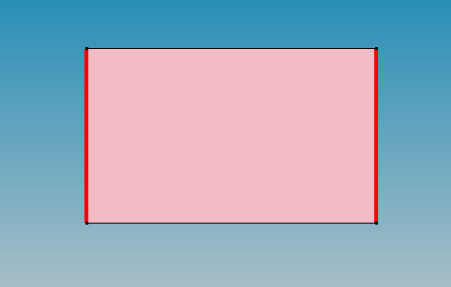
Contact Definition
To define a contact,
We have to activate the contact set we defined in the previous slide.
Then we have to select “Select Edge” in the drop-down list
We now have to select which edge we want to define the contact at and then go to Contacts-> Set Edges
Code:
(sdegeo:define-2d-contact (list (car (find-edge-id (position x1 y 0)))) "Electrode_1")
(sdegeo:define-2d-contact (list (car (find-edge-id (position x2 y 0)))) "Electrode_2")

Slide 12
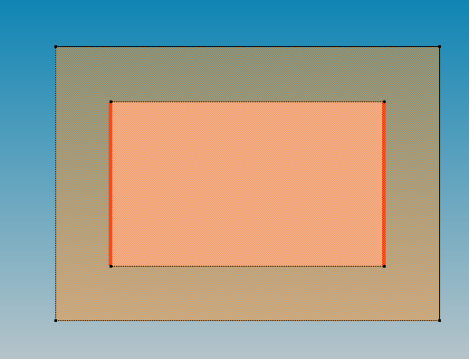
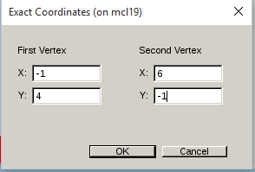
Meshing
Meshing is extremely important for solving equations inside the device.
To define meshing, we need to define a refinement window to define a global mesh.
Usually define a larger area than your device
Code:
(sdedr:define-refeval-window "RefEvalWin_1" "Rectangle" (position -1 4 0) (position 6 -1 0))

Slide 13
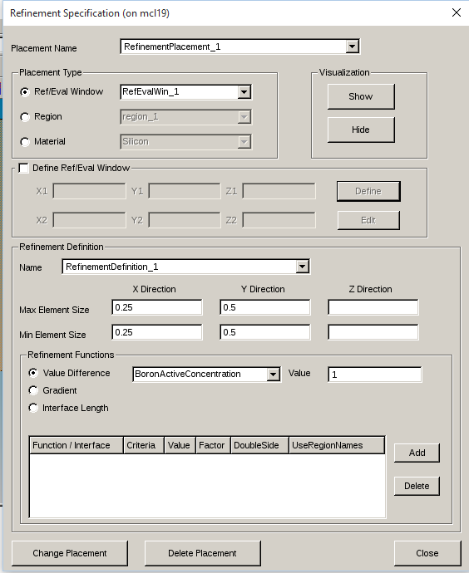
Meshing(Contd..)
We now need to associate the global refinement window with the refinement box
Select Mesh > Refinement Placement
Code:
(sdedr:define-refinement-size "RefinementDefinition_1" 0.25 0.5 0.25 0.5 )
(sdedr:define-refinement-placement "RefinementPlacement_1" "RefinementDefinition_1" "RefEvalWin_1" )

Slide 14
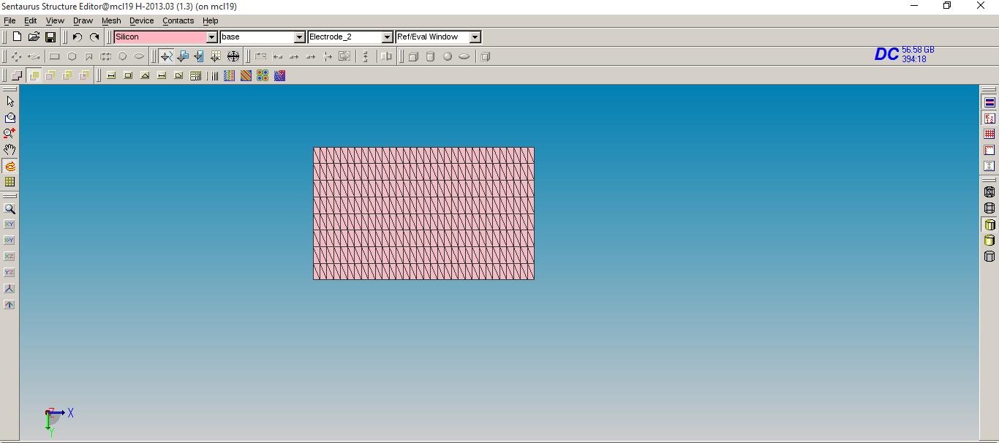
Meshing(Contd..)
Then go to Mesh-> Build Mesh
Code:
(sde:build-mesh "snmesh" "-a -c boxmethod" "sdemodel")
Your .tdr file is saved as sdemodel.tdr

Slide 15
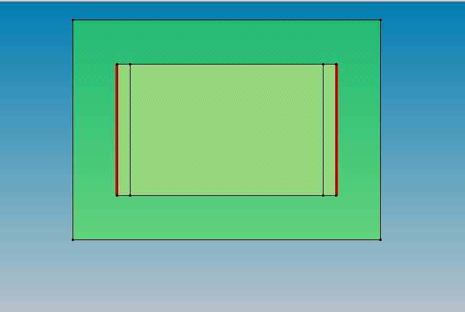
Meshing(Contd..)
You can change meshing by going to Mesh-> Refinement Placement again.
Suppose we need different meshing at some specific regions which we consider the most ‘sensitive’ regions
Lets take this current example and suppose we need finer meshing at the edges.
We define similar refinement windows at the edges

Slide 16
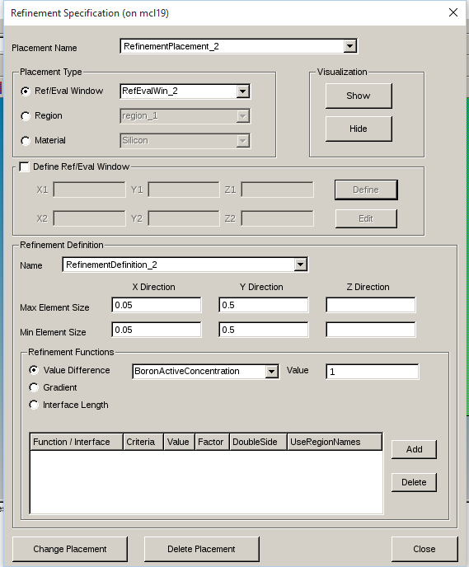
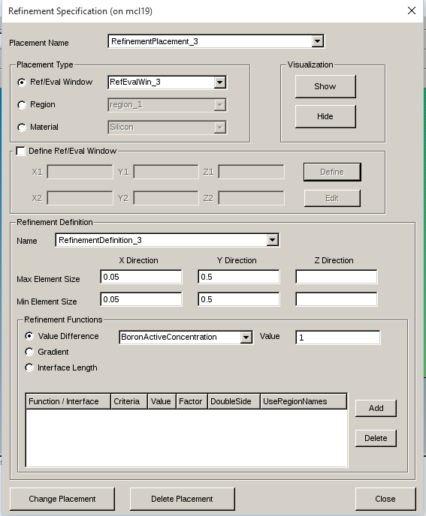
Meshing(Contd..)
Similar to previous refinement windows, we have to define refinement placements for these regions.

Slide 17
Meshing(Contd..)
Code:
(sdedr:define-refinement-placement "RefinementPlacement_2" "RefinementDefinition_2" "RefEvalWin_2" )
(sdedr:define-refinement-size "RefinementDefinition_2" 0.05 0.5 0.05 0.5 )
(sdedr:define-refinement-placement "RefinementPlacement_3" "RefinementDefinition_3" "RefEvalWin_3" )
(sdedr:define-refinement-size "RefinementDefinition_3" 0.05 0.5 0.05 0.5 )
Here, we have used finer meshing in the x-direction near the edges.

Slide 18
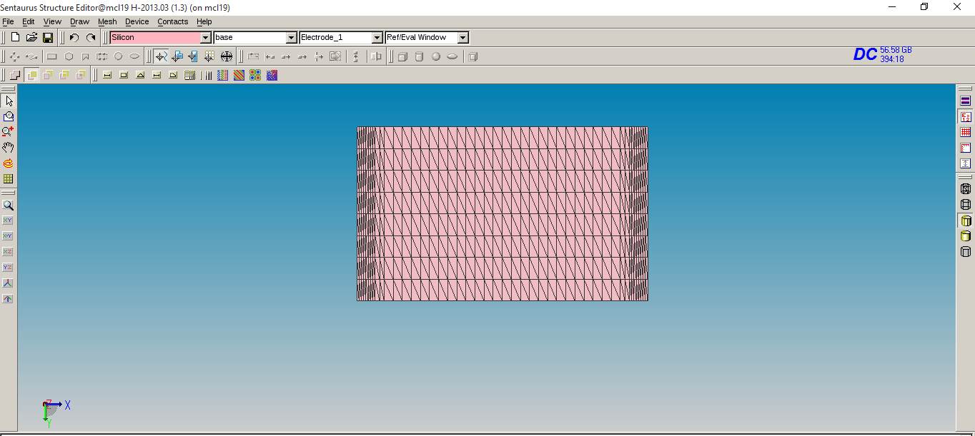
Meshing(Contd..)
We build the mesh again and here is what we get

Slide 19
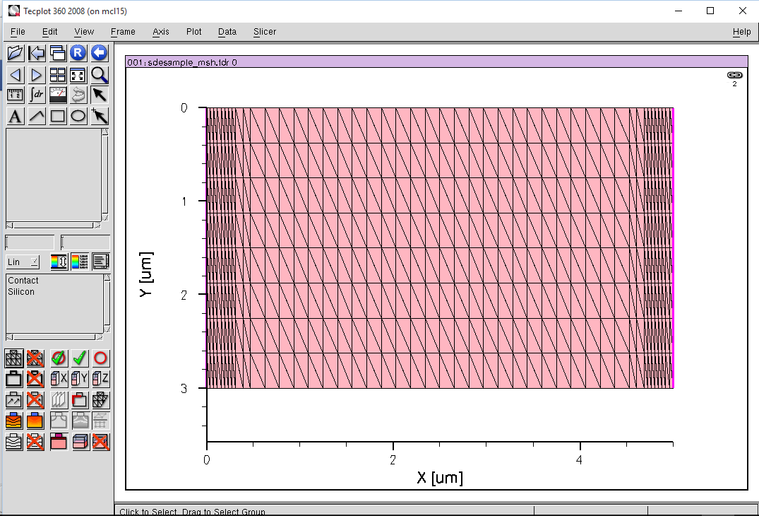
Visualizing the model
We can view our model in tecplot (command: tecplot_sv) or svisual (command: svisual)

Slide 20
Basics of scripting
An alternative way to use the SDE is scripting, which is often a convenient way.
SDE uses LISP-like programming.
It allows us to define our own set of variables for later use
(define i 3) ;Variable definition
(define nm 1e-3) ;nanometer definition
(define thick (* 2 nm)) ; Definition of 2 nm thickness
Arithmetic expressions are defined as
(define c (+a b)) ; c=a+b
These definitions help us defining co-ordinates for meshing and refinement windows.
For e.g. if we want a rectangular window extending ‘x’ distance from edge of the large rectangle(as used in example),
(define rec_edge 2)
(define window_edge (+x rec_edge))
(sdedr:define-refeval-window "RefEvalWin_n" "Rectangle" (position rec_edge y1 0) (position window_edge y2 0))

Slide 21
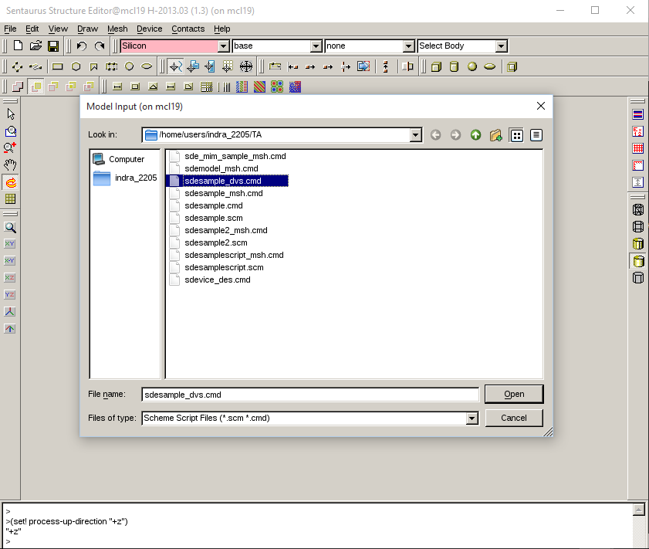
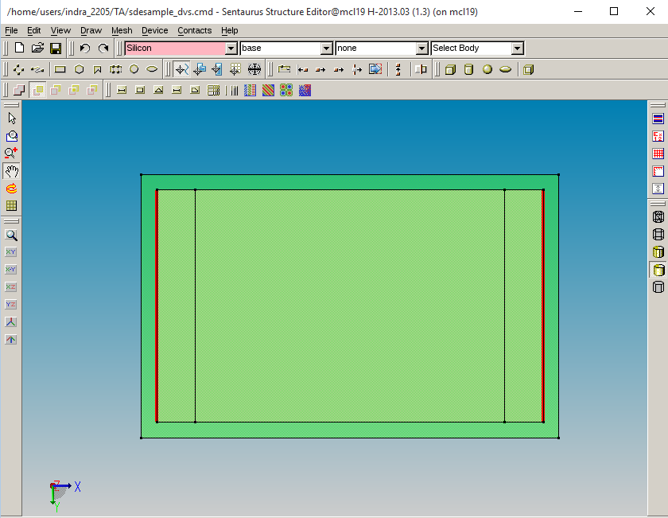
Importing a script into SDE
Select File->Import->``abc.cmd’’

Slide 22
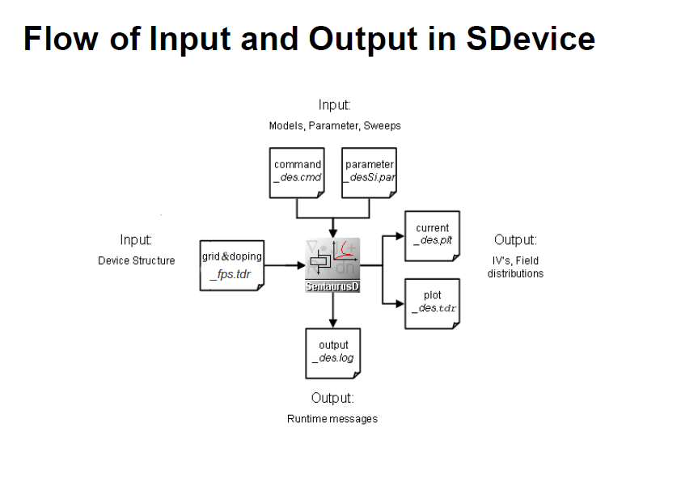
Numerical solution
Done using Sdevice
The Sentaurus Device command file is organized in command or statement sections that can be in any order

Slide 23
Command File
A typical device file contains following sections:
File
Electrode
Physics
Plot
Math
Solve

Slide 24
Command File
File section:
This section contains input files included and output files of the simulation
File {
*Input Files*
Grid = "_msh.tdr"
Parameter = “abc.par"
*Output Files*
Current = “abc"
Plot = “abc"
Output = “abc”
}

Slide 25
Command File
Electrode section:
The electrical device contacts are declared in the Electrode section together with the initial boundary conditions (bias) and other optional specifications.
Electrode {
{ Name= "n1contact" Voltage= 0.0 Schottky WorkFunction = wf1 }
{ Name= “n2contact" Voltage= 0.0 Schottky WorkFunction = wf2 }
}
By default, Sentaurus Device treats an electrode as an ideal Ohmic contact

Slide 26
Command File
Physics section:
The physical models that needs to be included in the simulation should be specified in the "Physics" section. The models you include should completely reflect the physical phenomenon happening in the device.
Physics {
Mobility ( DopingDep )
EffectiveIntrinsicDensity(BandGapNarrowing(oldSlotboom))
Recombination (SRH Auger )
}

Slide 27
Command File
Plot section:
The parameters that you want to visualize in the plot file after the device simulation, need to be included here
Plot {
Doping DonorConcentration AcceptorConcentration
BandGap BandGapNarrowing ElectronAffinity
ConductionBandEnergy ValenceBandEnergy
eQuasiFermiEnergy hQuasiFermiEnergy
eDensity hDensity
EffectiveIntrinsicDensity IntrinsicDensity
ElectricField/Vector
Potential eMobility hMobility SRHRecombination AugerRecombination TotalRecombination SurfaceRecombination
}

Slide 28
Command File
Math section:
This section directs the solver with information line, which numerical method to use during the solution, what should be the initial guess for each bias point, How many iteration it should wait to reduce the step size, if the convergence is not met. etc.,
Math {
Extrapolate * switches on solution extrapolation along a bias ramp
Iterations= 8 * maximum-allowed number of Newton iterations (3D)
Method= Blocked * default solvers for Coupled
RelErrControl
}

Slide 29
Command File
Solve section:
This is the actual section in which the solver is directed with the set of equations to solve. It consists of a series of simulation commands to be performed that are activated sequentially.
Solve{
Poisson
Electron
Hole
Coupled { Poisson Electron Hole }
NewCurrentFile="forwardbias"
Quasistationary (Initialstep= 0.025 MaxStep = 0.01 MinStep = 1e-8
Goal { Name = “n1contact" Voltage =-5})
{ Coupled { Poisson Electron Hole } }
}
Order of commands is important here

Slide 30
Tdr files
We can generate several tdr files by inserting regular halting commands.
For e.g, if we want to halt the simulation at 0.1V as visualize the tdr at that voltage, we can use
Quasistationary (Initialstep= 0.025 MaxStep=0.05 MinStep=0.0001
Goal{ Name="n2contact" Voltage= 0.1})
{ Coupled { Poisson Electron hole}
plot(FilePrefix=“0.1V_neg" )
CurrentPlot ( Time = (range = (0 1) intervals = 50))
}
The plot Fileprefix command saves a tdr file at that voltage.

Slide 31
Parameter File
Command to generate the default parameter file:
sdevice -P sdevice_file.cmd
This command generates the file models.par, which contains all the default model parameters for the silicon material.
To change the parameters for a model, for example, the parameters used by the Shockley–Read–Hall (SRH) model and to force Sentaurus Device to use the modified model parameters instead of the built-in defaults.

Slide 32
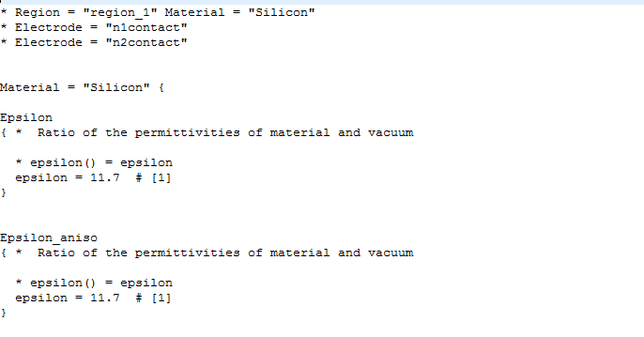
Parameter File
A sample section in parameter file looks like
We can change these values for our own convenience.

Slide 33
Result analysis
Tecplot SV
Inspect

Slide 34
Inspect
Inspect is a curve display and analysis program. It works with curves specified at discrete points. Inspect enables users to work interactively with data using both a graphical user interface and a script language
Inspect can be started from Sentaurus Workbench or from the command line by typing: inspect

Slide 35
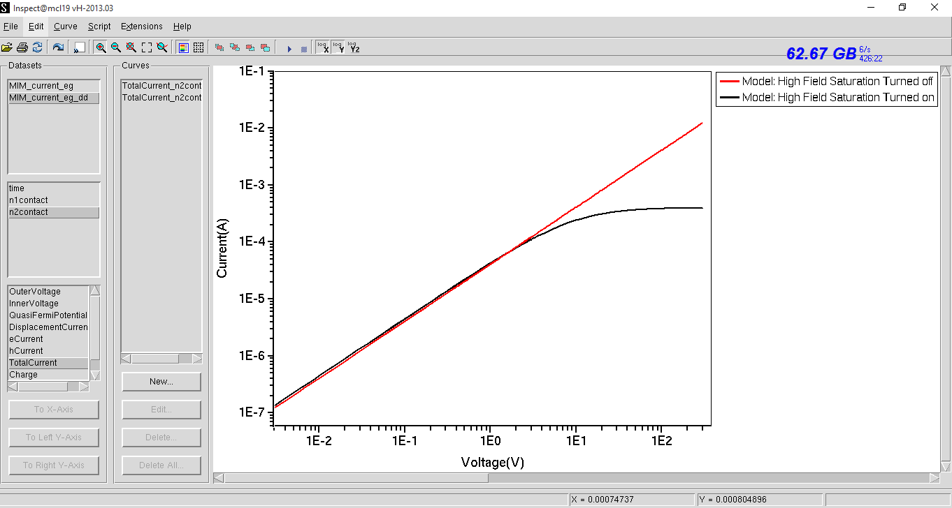
Viewing Output in inspect
File-> Load Dataset-> “abc.plt” -> Select Electrode-> Select Parameter to Plot

Slide 36
Tecplot SV
Tecplot SV is part of Sentaurus Workbench Visualization. It is plotting software with extensive 2D and 3D capabilities for visualizing data
The command tecplot_sv is used to start Tecplot from the command prompt, for example: tecplot_sv n2_fps.tdr
where n2_fps.tdr is the name of file.

Slide 37
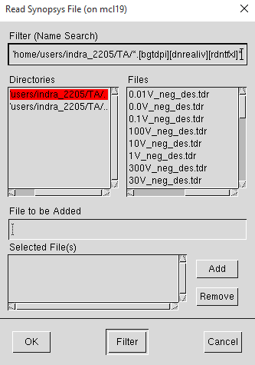
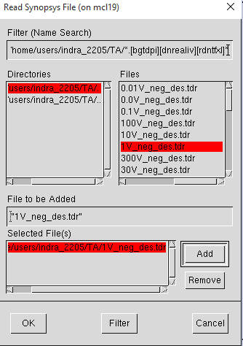
tecplot
To load data files from an open Tecplot SV interface:
File > Load

Slide 38
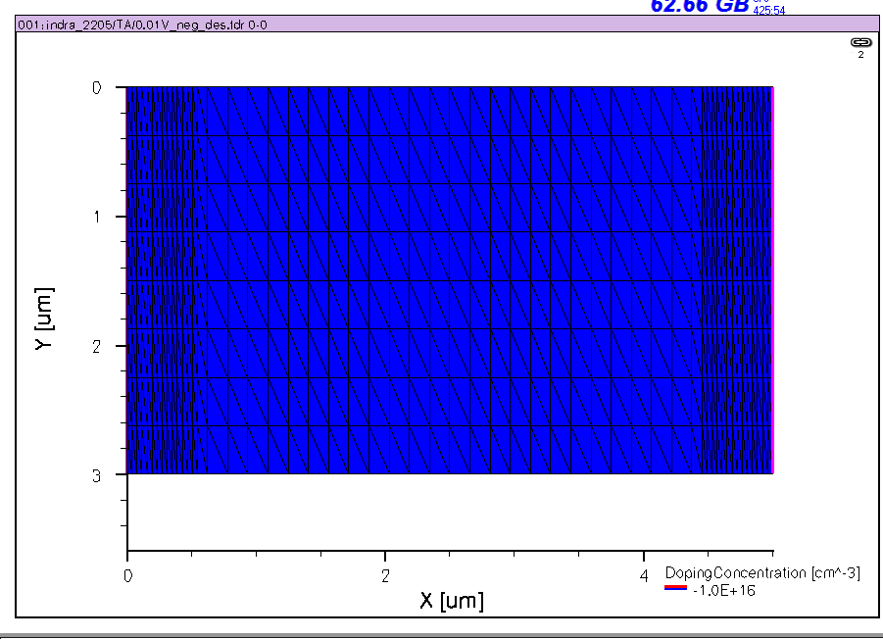
Visualizing the structure

Slide 39
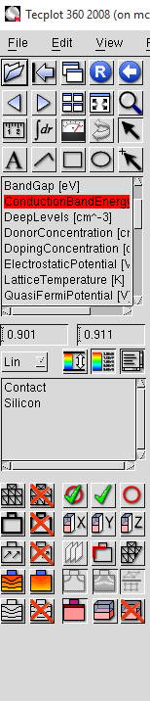
Plots from Tdr files
We can plot all the parameters that we included in the plot section in tecplot/svisual visualization of the tdr file
For example if we want to plot Conduction Band energy, we need to take a y-cut along the structure and the select Conduction Band energy

Slide 40
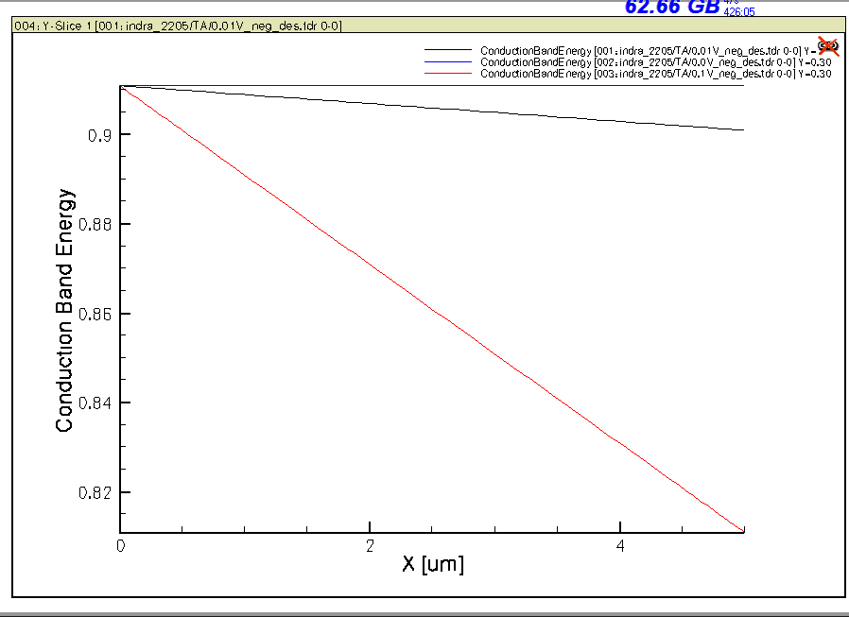
Conduction Band energies

Slide 41
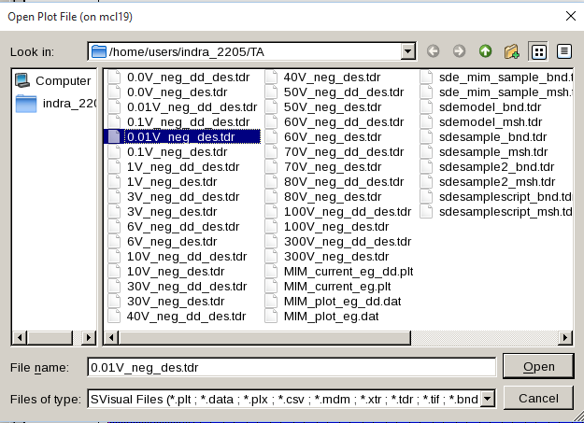
svisual
Command to open svisual: svisual
To load data files from the graphical user interface (GUI) of Sentaurus Visual:
File > Open

Slide 42
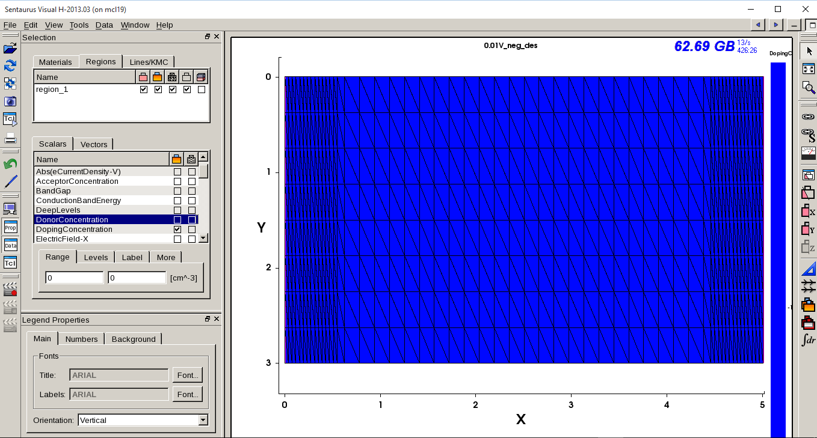
svisual

Slide 43
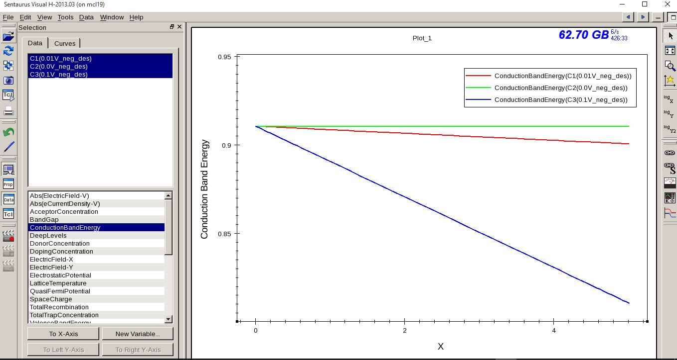
Plotting Tdr files in svisual
Select tdr file
Take y-cut
Select Parameter

Slide 44
Sentaurus Manuals and Training
For Sentaurus Training, go to directory mentioned below and open index.html in firefox browser.
cd /usr/local/Softwares/Sentaurus/Sentaurus_vF_2011.09/tcad/F-2011.09/Sentaurus_Training/
And manuals are in the following directory
cd/usr/local/Softwares/Sentaurus/Sentaurus_vF_2011.09/tcad/F-2011.09/manuals
Note: Various versions are available. You can access manuals from any of those. Ex:
cd/usr/local/Softwares/Sentaurus/Sentaurus_vO_2018.06/O_2018.06-SP1/tcad/O-2018.06-SP1/manuals/PDFManual/data/

Slide 45
Thank You

